Slide 1

CMPG321 Advanced Databases
SQL
SU5 – Ch 7 & 8 (13th) or Ch 8 & 9 (3rd)
Monday 02 September

Slide 2
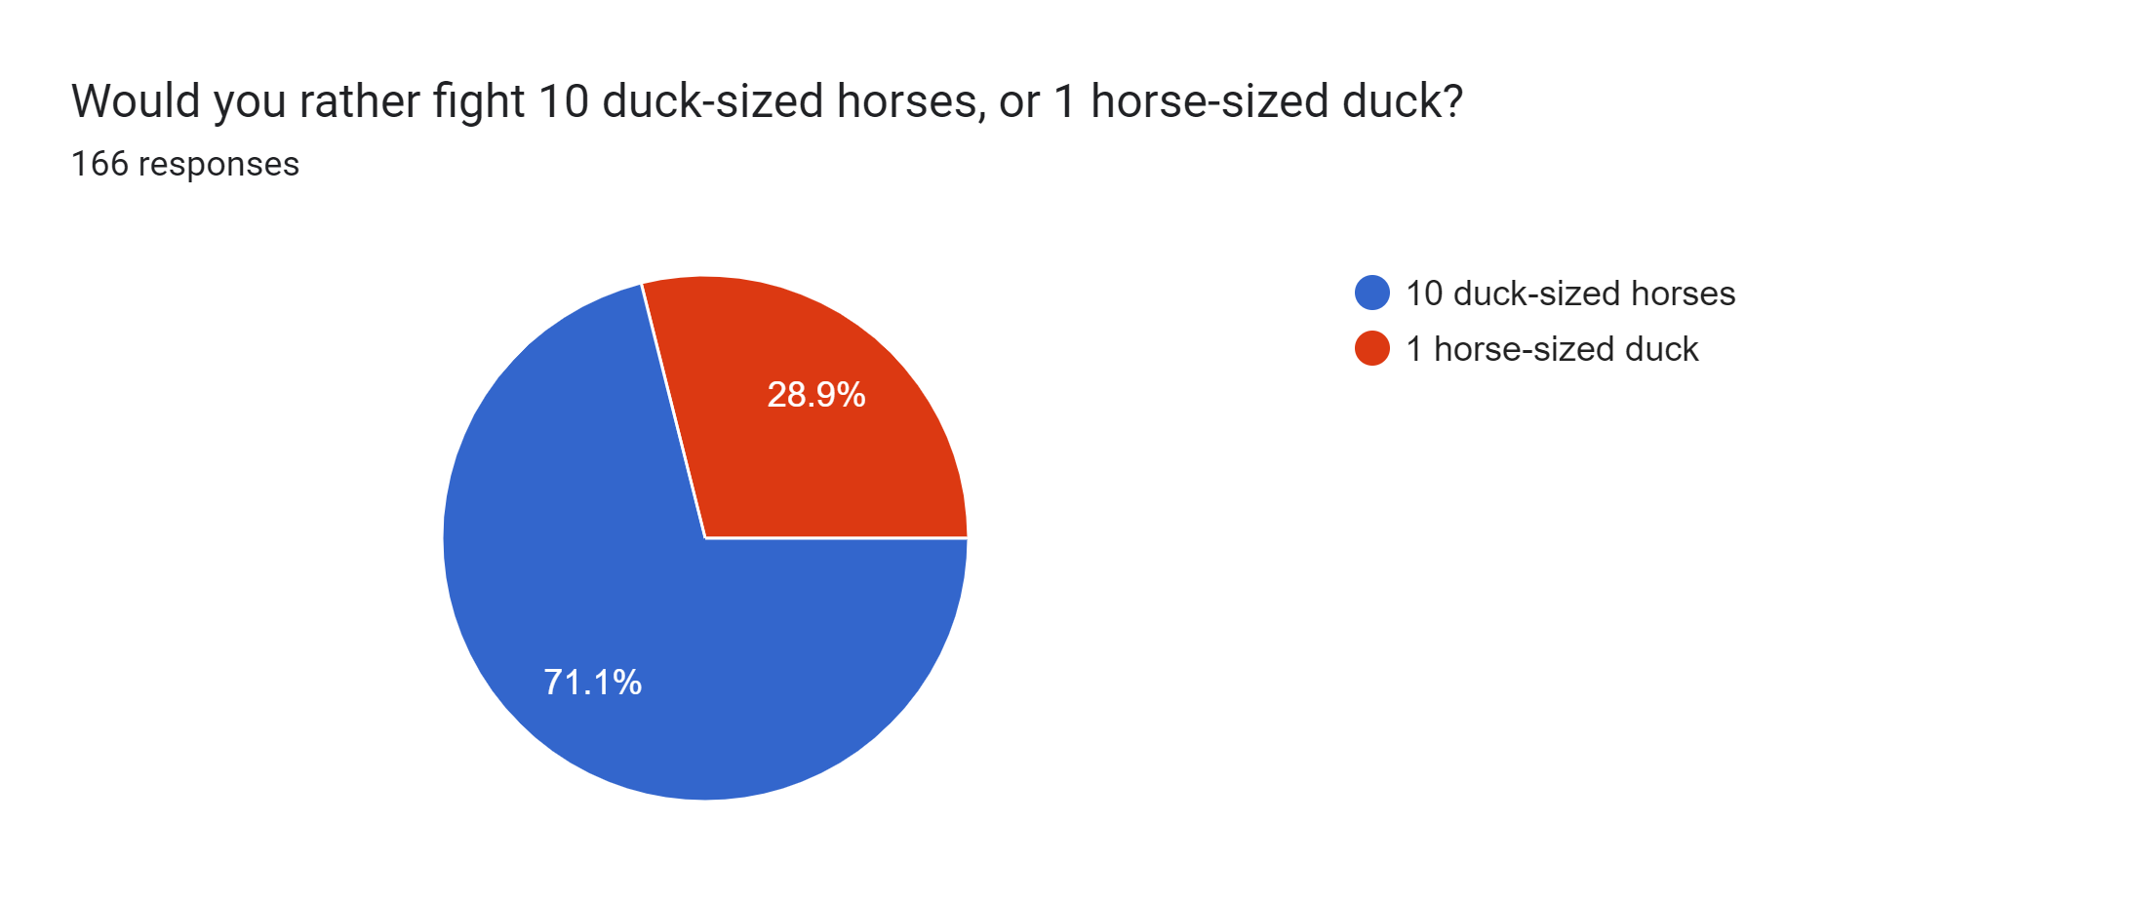

Attendance of 26 August

Slide 3


Semester Test
Sit-down invigilated (Venue?.. – check)
Tuesday 10 September @ 14:00
Study Unit 1-5
60 Marks || 1 Hour
Test structure:
Question 1 – Transaction Management & Concurrency Control [14]
Question 2 – DBMS & Query Optimisation [10]
Question 3 – Distributed Database Management Systems [14]
Question 4 – Business Intelligence & Data Warehouses [10]
Question 5 – Multiple choice (SQL) [12]

Slide 4
CMPG321 Advanced Databases
SQL
SU5
Monday 02 September

Slide 5

CMPG321 – HW Exercise
Skryf ‘n enkele SQL stelling om die volgende te doen: Onttrek die werknemer ID (EMP_ID), aanstel datum (EMP_HIRE_DATE), salaris (EMP_SALARY) en kommissie (EMP_COMM) van werknemers met kommissie ongelyk aan nul op die EMPLOYEE tabel. Vir elke werknemer rekord onttrek, word die werknemer ID (EMP_ID), aanstel datum (EMP_HIRE_DATE) en salaris (EMP_SALARY) bygevoeg word op die EMP_HISTORY tabel, die werknemer ID (EMP_ID), jaar van vandag se datum, maand van vandag se datum, kommissie (EMP_COMM) en salaris (EMP_SALARY) word bygevoeg in die EMP_SALES tabel en die werknemer ID (EMP_ID) en salaris (EMP_SALARY) word bygevoeg word in die DEPT_MANAGERS tabel.
Write a single SQL statement to do the following: Retrieve the employee id (EMP_ID), hire date (EMP_HIRE_DATE), salary (EMP_SALARY) and commission (EMP_COMM) of those employees with commission not equal to zero on the EMPLOYEE table. For each employee record retrieved the employee ID (EMP_ID), hire date (EMP_HIRE_DATE) and salary (EMP_SALARY) are inserted into the EMP_HISTORY table, the employee ID (EMP_ID), year of the today’s date, month of today’s date, commission (EMP_COMM) and salary (EMP_SALARY) are inserted into the EMP_SALES table and the employee ID (EMP_ID), and salary (EMP_SALARY) are inserted into the DEPT_MANAGERS table.

Slide 6
CMPG321 – HW Exercise
INSERT ALL INTO EMP_HISTORY VALUES(EMP_ID, EMP_HIRE_DATE, EMP_SALARY) INTO EMP_SALES VALUES(EMP_ID, EXTRACT(YEAR FROM SYSDATE), EXTRACT(MONTH FROM SYSDATE), EMP_COMM, EMP_SALARY) INTO DEPT_MANAGERS VALUES(EMP_ID, EMP_SALARY) SELECT EMP_ID, EMP_HIRE_DATE, EMP_SALARY, EMP_COMM FROM EMPLOYEE WHERE EMP_COMM > 0 ;

Slide 7
Additional SQL (SQL Fundamentals 2)
1 – Controlling User Access
2 – Managing Schema Objects
3 – Managing Objects with Data Dictionary Views
4 – Manipulating Large Data Sets
5 – Managing Data in Different Time Zones

Slide 8
1 – Controlling User Access

Slide 9
Outcomes
Differentiate system privileges from object privileges
Grant privileges on tables
Grant roles
Distinguish between privileges and roles

Slide 10
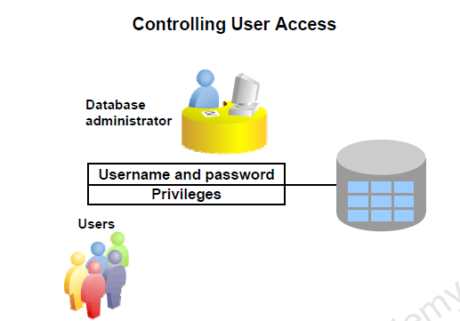
Privileges
Two types of DB Security:
System security
Data security

Slide 11
Privileges
System privileges: Performing a particular action within the database
Object privileges: Manipulating the content of the database objects
Schemas: Collection of objects such as tables, views, and sequences

Slide 12
Privileges
A schema is a collection of objects such as tables, views, and sequences. The schema is owned by a database user and has the same name as that user.
A system privilege is the right to perform a particular action, or to perform an action on any schema objects of a particular type.
An object privilege provides the user the ability to perform a particular action on a specific schema object.

Slide 13
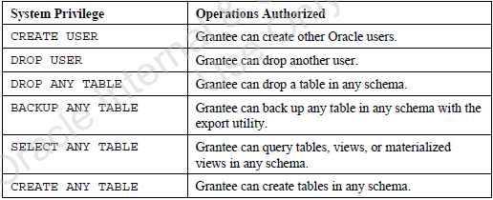
System Privileges
The database administrator has high-level system privileges for tasks such as:
– Creating new users
– Removing users
– Removing tables
– Backing up tables

Slide 14
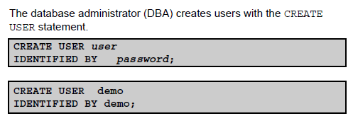
Creating Users

Slide 15
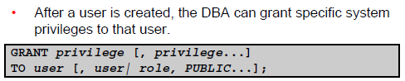
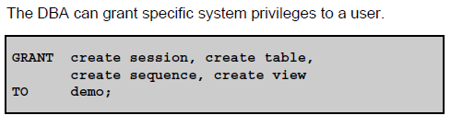

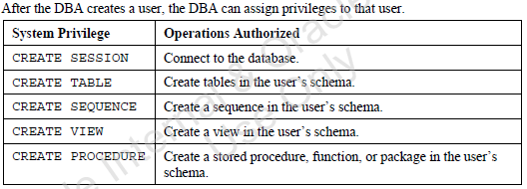
User System Privileges

Slide 16
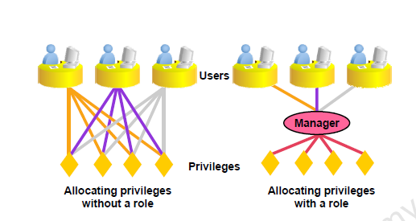
What Is a Role?
A role is a named group of related privileges that can be granted to the user. This method makes it easier to revoke and maintain privileges. A user can have access to several roles, and several users can be assigned the same role. Roles are typically created for a database application.

Slide 17
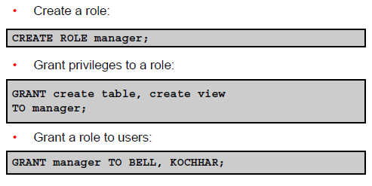

Creating and Granting Privileges to a Role

Slide 18
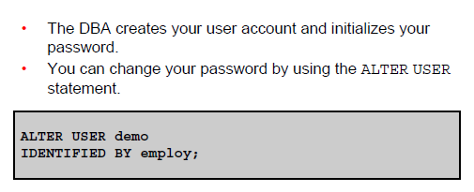
Changing Your Password

Slide 19
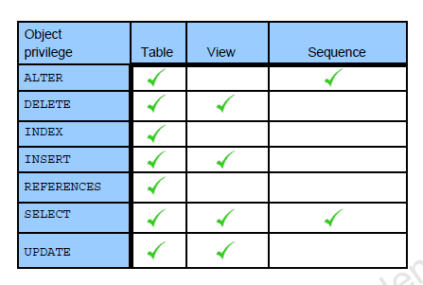
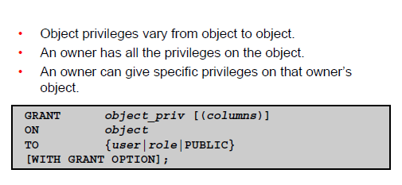
Object Privileges

Slide 20
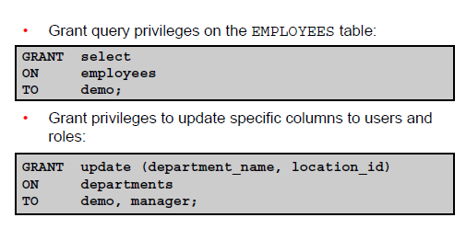

Granting Object Privileges

Slide 21
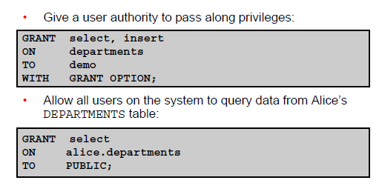

Passing On Your Privileges

Slide 22
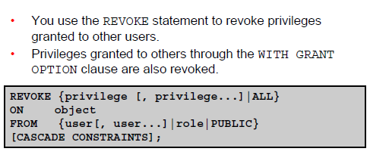
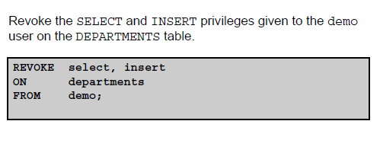

Revoking Object Privileges

Slide 23
Summary
DBAs establish initial database security for users by assigning privileges to the users.
The DBA creates users who must have a password. The DBA is also responsible for establishing the initial system privileges for a user.
After the user has created an object, the user can pass along any of the available object privileges to other users or to all users by using the GRANT statement.
A DBA can create roles by using the CREATE ROLE statement to pass along a collection of system or object privileges to multiple users. Roles make granting and revoking privileges easier to maintain.
Users can change their passwords by using the ALTER USER statement.
You can remove privileges from users by using the REVOKE statement.
With data dictionary views, users can view the privileges granted to them and those that are granted on their objects.

Slide 24
2 – Managing Schema Objects

Slide 25
Outcomes
• Add constraints
• Create indexes
• Create indexes using the CREATE TABLE statement
• Create function-based indexes

Slide 26
ALTER TABLE Statement
Use the ALTER TABLE statement to:
Add a new column
Modify an existing column
Define a default value for the new column
Drop a column

Slide 27
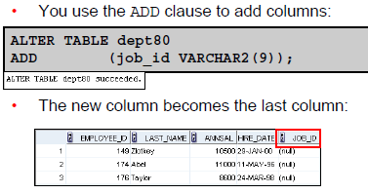

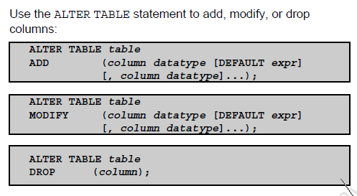
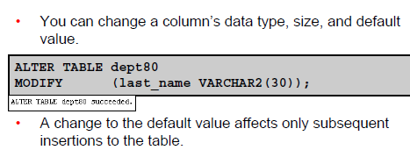
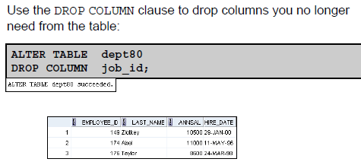
ALTER TABLE Statement

Slide 28
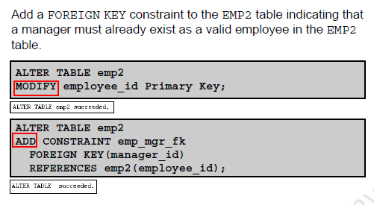
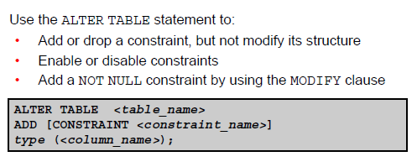

Adding a Constraint Syntax

Slide 29
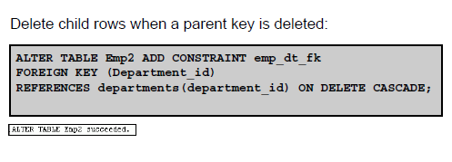
ON DELETE CASCADE
The ON DELETE CASCADE action allows parent key data that is referenced from the child table to be deleted, but not updated. When data in the parent key is deleted, all rows in the child table that depend on the deleted parent key values are also deleted. To specify this referential action, include the ON DELETE CASCADE option in the definition of the FOREIGN KEY constraint.

Slide 30
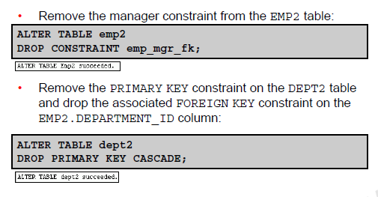
Dropping a Constraint

Slide 31
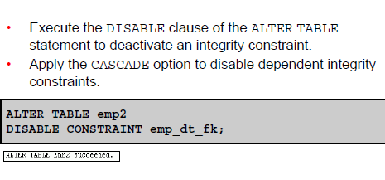
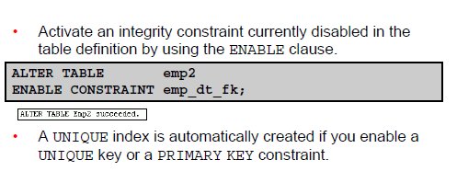
Disabling Constraints
Enabling Constraints

Slide 32
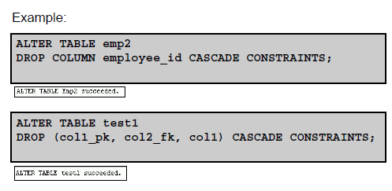
Cascading Constraints
The CASCADE CONSTRAINTS clause is used along with the DROP COLUMN clause.
The CASCADE CONSTRAINTS clause drops all referential integrity constraints that refer to the primary and unique keys defined on the dropped columns.
The CASCADE CONSTRAINTS clause also drops all multicolumn constraints defined on the dropped columns.

Slide 33
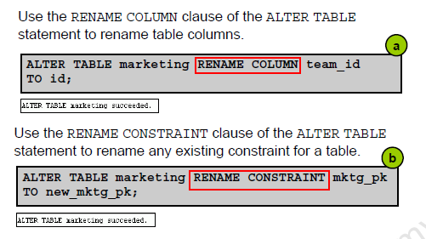
Renaming Table Columns and Constraints

Slide 34
Overview of Indexes
Indexes are created:
Automatically
– PRIMARY KEY creation
– UNIQUE KEY creation
Manually
– The CREATE INDEX statement
– The CREATE TABLE statement

Slide 35
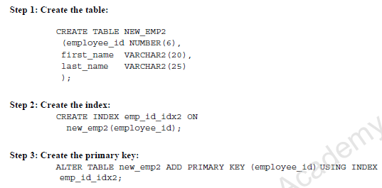
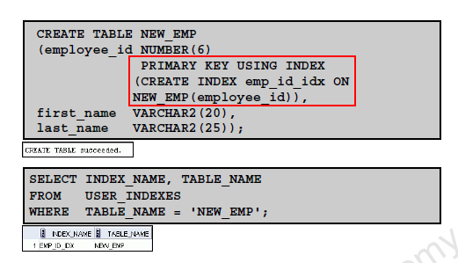
CREATE INDEX with the CREATE TABLE Statement
METHOD 1
METHOD 2

Slide 36
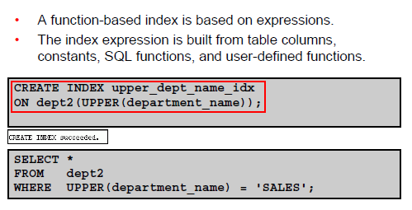
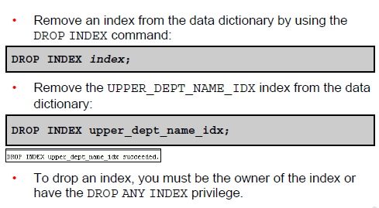
Function-Based Indexes
Removing an Index

Slide 37
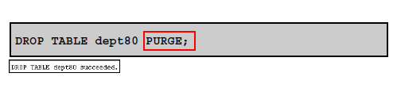
DROP TABLE … PURGE
Specify PURGE only if you want to drop the table and release the space associated with it in a single step. If you specify PURGE, then the database does not place the table and its dependent objects into the recycle bin.

Slide 38
Summary
Alter tables to add or modify columns or constraints.
Create indexes and function-based indexes by using the CREATE INDEX statement.
Name your PRIMARY KEY column indexes when you create the table with the CREATE TABLE statement.

Slide 39
3 – Managing Objects with Data Dictionary Views

Slide 40
Outcomes
Use the data dictionary views to research data on your objects
Query various data dictionary views

Slide 41
Privileges
Two types of DB Security:
System security
Data security

Slide 42
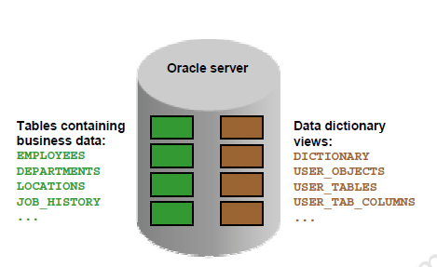
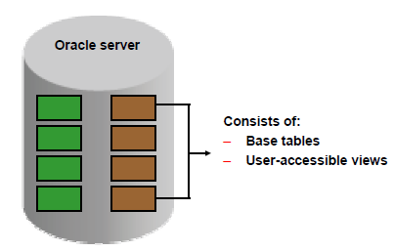
Data Dictionary
A data dictionary, also called a data definition matrix, provides detailed information about the business data, such as standard definitions of data elements, their meanings, and allowable values.
The data dictionary is structured in tables and views, just like other database data.

Slide 43
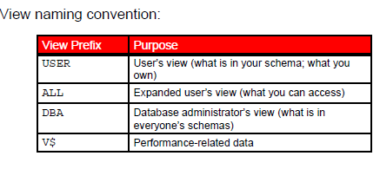
Data Dictionary Structure

Slide 44
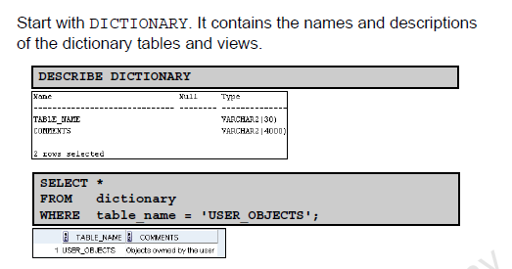
How to Use the Dictionary Views

Slide 45
USER_OBJECTS and ALL_OBJECTS Views
USER_OBJECTS:
Query USER_OBJECTS to see all the objects that you own
Is a useful way to obtain a listing of all object names and types in your schema, plus the following information:
– Date created
– Date of last modification
– Status (valid or invalid)
ALL_OBJECTS:
Query ALL_OBJECTS to see all objects to which you have access

Slide 46
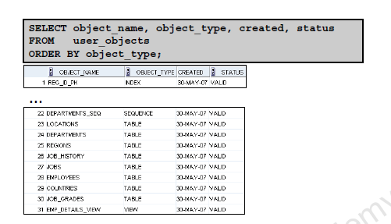
USER_OBJECTS View

Slide 47
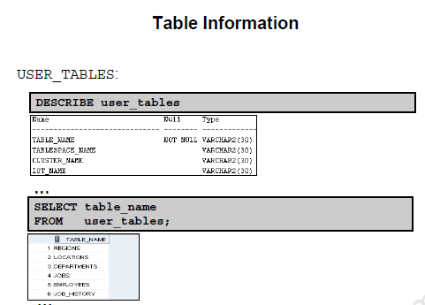
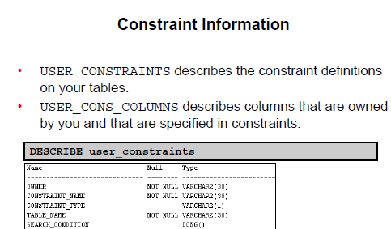
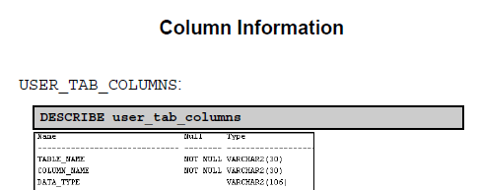
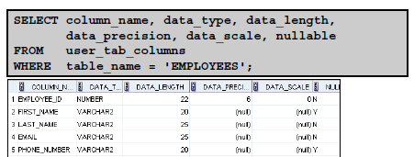
Querying the dictionary views for the following:

Slide 48
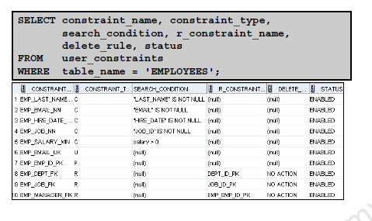
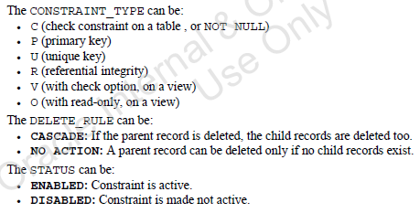
USER_CONSTRAINTS: Example

Slide 49
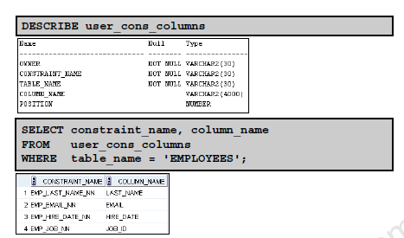
Querying USER_CONS_COLUMNS

Slide 50
Querying dictionary views
Querying the dictionary views for the following:
– View information
– Sequence information
– Synonym information
– Index information

Slide 51
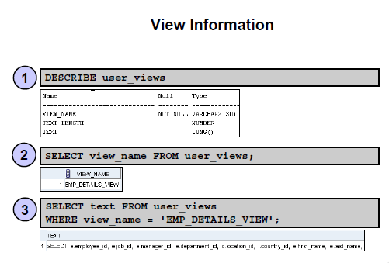
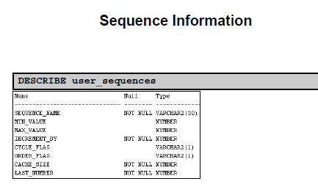
Querying the dictionary views for the following:

Slide 52
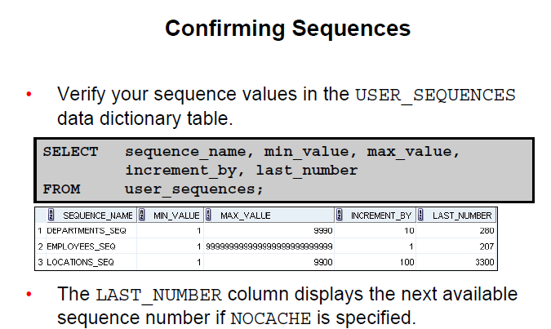
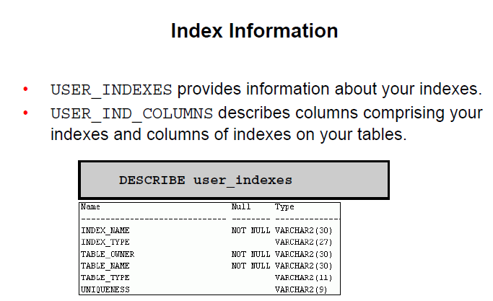
Querying the dictionary views for the following:

Slide 53
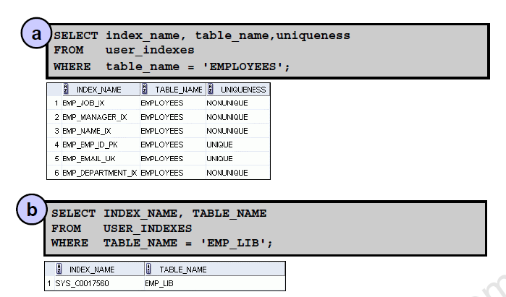
USER_INDEXES: Examples

Slide 54

Querying USER_IND_COLUMNS

Slide 55

Synonym Information

Slide 56

Adding Comments to a Table

Slide 57
Summary
DICTIONARY
USER_OBJECTS
USER_TABLES
USER_TAB_COLUMNS
USER_CONSTRAINTS
USER_CONS_COLUMNS
USER_VIEWS
USER_SEQUENCES
USER_INDEXES
USER_SYNONYMS

Slide 58
4 – Manipulating Large DATA SETS

Slide 59
Outcomes
Manipulate data using subqueries
Specify explicit default values in the INSERT and UPDATE statements
Describe the features of multitable INSERTs
Use the following types of multitable INSERTs:
– Unconditional INSERT
– Conditional INSERT ALL
– Conditional INSERT FIRST
Merge rows in a table
Track the changes to data over a period of time

Slide 60
Using Subqueries to Manipulate Data
You can use subqueries in data manipulation language (DML) statements to:
Retrieve data using an inline view
Copy data from one table to another
Update data in one table based on the values of another table
Delete rows from one table based on rows in another table

Slide 61


Slide 62

Retrieving Data Using a Subquery as Source

Slide 64

Inserting Using a Subquery as a Target

Slide 65

Inserting Using a Subquery as a Target(Cont)

Slide 66

Using the WITH CHECK OPTION Keyword on DML Statements

Slide 67
Overview of the Explicit Default Feature
Use the DEFAULT keyword as a column value where the default column value is desired.
This allows the user to control where and when the default value should be applied to data.
Explicit defaults can be used in INSERT and UPDATE statements.

Slide 68

Using Explicit Default Values

Slide 69

Copying Rows from Another Table

Slide 70

(SQL FUnd2-5) EXTRACT

Slide 71

Overview of Multitable INSERT Statements

Slide 72
Overview of Multitable INSERT Statements
Use the INSERT…SELECT statement to insert rows into multiple tables as part of a single DML statement.
Multitable INSERT statements are used in data warehousing systems to transfer data from one or more operational sources to a set of target tables.
They provide significant performance improvement over:
– Single DML versus multiple INSERT…SELECT statements
– Single DML versus a procedure to perform multiple inserts by using the IF...THEN syntax

Slide 73
Types of Multitable INSERT Statements
The different types of multitable INSERT statements are:
Unconditional INSERT: For each row returned by the subquery, a row is inserted into each of the target tables.
Conditional INSERT ALL: For each row returned by the subquery, a row is inserted into each target table if the specified condition is met.
Conditional INSERT FIRST: For each row returned by the subquery, a row is inserted into the very first target table in which the condition is met.

Slide 74

Multitable INSERT Statements

Slide 75
Unconditional INSERT ALL
Select the EMPLOYEE_ID, HIRE_DATE, SALARY, and MANAGER_ID values from the EMPLOYEES table for those employees whose EMPLOYEE_ID is greater than 200.
Insert these values into the SAL_HISTORY and MGR_HISTORY tables by using a multitable INSERT.
SAL_HISTORY (EMP_ID, HIRE_DATE, SAL)
MGR_HISTORY (EMP_ID, MGR, SAL)

Slide 76

Unconditional INSERT ALL
Select the EMPLOYEE_ID, HIRE_DATE, SALARY, and MANAGER_ID values from the EMPLOYEES table for those employees whose EMPLOYEE_ID is greater than 200.
Insert these values into the SAL_HISTORY and MGR_HISTORY tables by using a multitable INSERT.

Slide 77

Conditional INSERT ALL: Example

Slide 78

Conditional INSERT ALL

Slide 79

Conditional INSERT FIRST: Example

Slide 80

Conditional INSERT FIRST

Slide 81
MERGE Statement
Provides the ability to conditionally update, insert, or delete data into a database table
Performs an UPDATE if the row exists, and an INSERT if it is a new row:
– Avoids separate updates
– Increases performance and ease of use
– Is useful in data warehousing applications

Slide 82

MERGE Statement Syntax

Slide 83


MERGE Statement Syntax

Slide 84
Summary
Use DML statements and control transactions
Describe the features of multitable INSERTs
Use the following types of multitable INSERTs:
– Unconditional INSERT
– Conditional INSERT ALL
– Conditional INSERT FIRST
Merge rows in a table
Manipulate data by using subqueries

Slide 85
5 – Managing Data in Different time zones

Slide 86
Outcomes
After completing this lesson, you should be able to do the following:
Use data types similar to DATE that store fractional seconds and track time zones
Use data types that store the difference between two datetime values
Use the following datetime functions:
– CURRENT_DATE
– CURRENT_TIMESTAMP
– LOCALTIMESTAMP
– DBTIMEZONE
– SESSIONTIMEZONE
– EXTRACT
– TZ_OFFSET
– FROM_TZ
– TO_TIMESTAMP
– TO_YMINTERVAL
– TO_DSINTERVAL

Slide 87

TIME_ZONES

Slide 88

TIME_ZONE Session Parameter

Slide 89
CURRENT_DATE, CURRENT_TIMESTAMP, and LOCALTIMESTAMP
CURRENT_DATE:
– Returns the current date from the user session
– Has a data type of DATE
CURRENT_TIMESTAMP:
– Returns the current date and time from the user session
– Has a data type of TIMESTAMP WITH TIME ZONE
LOCALTIMESTAMP:
– Returns the current date and time from the user session
– Has a data type of TIMESTAMP

Slide 90

Comparing Date and Time in a Session’s Time Zone

Slide 91

Comparing Date and Time in a Session’s Time Zone

Slide 92

DBTIMEZONE and SESSIONTIMEZONE

Slide 93

TIMESTAMP Data Types

Slide 94

TIMESTAMP Fields

Slide 95

Difference Between DATE and TIMESTAMP

Slide 96

Comparing TIMESTAMP Data Types

Slide 97

INTERVAL Data Types

Slide 98

INTERVAL Fields

Slide 99

INTERVAL YEAR TO MONTH: Example

Slide 100

INTERVAL DAY TO SECOND Data Type: Example

Slide 101
EXTRACT

Slide 102


TZ_OFFSET
FROM_TZ

Slide 103


TO_TIMESTAMP
TO_YMINTERVAL

Slide 104

TO_DSINTERVAL

Slide 105
Daylight Saving Time
First Sunday in April
– Time jumps from 01:59:59 AM to 03:00:00 AM.
– Values from 02:00:00 AM to 02:59:59 AM are not valid.
Last Sunday in October
– Time jumps from 02:00:00 AM to 01:00:01 AM.
– Values from 01:00:01 AM to 02:00:00 AM are ambiguous because they are visited twice.

Slide 106
Summary
CURRENT_DATE
CURRENT_TIMESTAMP
LOCALTIMESTAMP
DBTIMEZONE
SESSIONTIMEZONE
EXTRACT
TZ_OFFSET
FROM_TZ
TO_TIMESTAMP
TO_YMINTERVAL
TO_DSINTERVAL

Slide 107
CMPG321 – Merge All - HW Challenge
You must create a database for a decision support system (DSS). During interviews with users the average- and total salary (SALARY) of employees per month (month of HIRE_DATE) per department (DEPARTMENT_ID) was identified as information requirement. Consider the detailed star schema for this information requirement below and answer the questions that follow.
Jy moet ŉ databasis skep vir ŉ besluitsteunstelsel (BSS). Tydens onderhoude met gebruikers word die gemiddelde- en totale salaris (SALARY) van werknemers per maand (maand van HIRE_DATE) per departement (DEPARTMENT_ID) as inligtingsbehoefte geïdentifiseer. Beskou die gedetailleerde ster skema wat vir hierdie inligtingsbehoefte hieronder gegee is en beantwoord die vrae wat volg.

Slide 108
CMPG321 – Merge All - HW Challenge
After the fact table is created and data is initially loaded from the operational database into SALARIES_FACT, the detail of new appointments (HIRE_DATE) should be UPDATED DAILY from the operational database into the fact table, SALARIES_FACT. Write a SQL statement to do that.
Nadat die feitetabel geskep is en data aanvanklik uit die operasionele databasis oorgelaai is in SALARIES_FACT, moet die detail van nuwe aanstellings (HIRE_DATE) uit die operasionele databasis DAAGLIKS in die feite tabel, SALARIES_FACT, opgedateer word. Skryf ŉ SQL stelling om dit te doen. /

Slide 109
Semester Test
Sit-down invigilated (Venue?.. – check)
Tuesday 10 September @ 14:00
Study Unit 1-5
60 Marks || 1 Hour
Test structure:
Question 1 – Transaction Management & Concurrency Control [14]
Question 2 – DBMS & Query Optimisation [10]
Question 3 – Distributed Database Management Systems [14]
Question 4 – Business Intelligence & Data Warehouses [10]
Question 5 – Multiple choice (SQL) [12]

Slide 110
CMPG321
Homework assignment
Revision Quiz SU5 – Opens today
Wednesday – Assignment 3 - SQL
Go through (Ch 7 & 8 - 13th ed.; Ch 8 & 9 – 3th ed.) - SQL & SQL Slides on eFundi
Group Project
Phase 2 – Database Setup & Load Airbnb data into DBMS of your choice

